Slide 1
Brandie Nonnecke, PhD
Director, CITRIS Policy Lab
Assoc. Research Professor, Goldman School of Public Policy
UC Berkeley
@BrandieNonnecke | nonnecke@berkeley.edu
2025
State AI Governance
Strategies & Tools

Slide 2
State & Local Approaches to AI Governance
Fri., Feb. 28 | 11:05 a.m. – 12:25 p.m.
Paul Ohm, Georgetown Law
Jonathan Porat, California Department of Technology
Jennifer Urban, UC Berkeley Center for Law & Technology (BCLT)
Brandie Nonnecke, CITRIS Policy Lab & UC Berkeley Center for Law & Technology (BCLT) (Moderator)

Slide 4
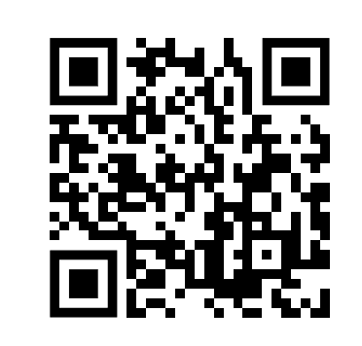

Slide 5
SB-1047

Slide 6
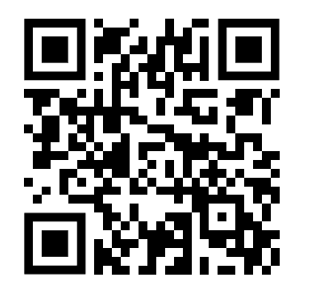
AI Action Summit

Slide 7
Notes:
GenAI is the shiny, advanced tool that we all find mesmerizing. BUT! It is unlikely to be the AI tool you need to solve your biggest problems.

Slide 8
Not all AI is GenAI

Slide 9
Notes:
Everyone is looking at adopting generative AI tools. This is like the phrase “When you walk around with a hammer everything looks like a nail.” If you only think about GenAI in your toolbox, you will try to apply it inappropriately. This will result in financial, reputational, and legal risks.

Slide 10
AI DEFINED BY COMPUTER SCIENCE
Machine Learning
Machine learning (ML), the most commonly used form of AI, refers to a broad set of techniques that use data to create algorithms that are often used to predict outcomes.
Supervised vs. Unsupervised ML
Deep Learning
Reinforcement Learning
Deep Learning
Generative AI
Foundation Models / General-Purpose AI Systems
Notes:
Note: Narrow AI can included augmented intelligence. Narrow (or weak) AI focuses on a simple task (e.g., virtual assistants are an example of narrow AI).
Supervised vs. unsupervised
Supervised learning infers a function from labeled training data. This training data consisting of a set of training examples to map an input to an output based on example input-output pairs.
Unsupervised learning

Slide 11
MACHINE LEARNING

Slide 12
Supervised Machine Learning
Unsupervised Machine Learning
Reinforcement Learning
Deep Learning
Generative AI
Foundation Models
General-Purpose AI
Frontier Models

Slide 13
AI DEFINED BY LAWS & INSTITUTIONS
The United States’ National Artificial Intelligence Act of 2020 defines 'Artificial Intelligence' (AI) as:
"A machine-based system that can, for a given set of human-defined objectives, make predictions, recommendations or decisions influencing real or virtual environments.”
The OECD updated its definition of an ‘AI system’ in 2023 to the following:
“An AI system is a machine-based system that, for explicit or implicit objectives, infers, from the input it receives, how to generate outputs such as predictions, content, recommendations, or decisions that can influence physical or virtual environments. Different AI systems vary in their levels of autonomy and adaptiveness after deployment.”

Slide 14
AI DEFINED BY LAWS & INSTITUTIONS
“an engineered or machine-based system that varies in its level of autonomy and that can, for explicit or implicit objectives, infer from the input it receives how to generate outputs that can influence physical or virtual environments.
California Legal Definition of AI (AB-2885)

Slide 15
Why are governments hyped about AI?

Slide 16
AI to Improve Government Efficiency & Effectiveness
Process Automation
Automates repetitive tasks (e.g., processing permits, managing tax records), reducing administrative overhead and freeing up staff for more strategic work.
Data-Driven Decision-Making
AI analyzes vast datasets to provide insights for more informed policymaking (e.g., predictive analytics for public safety, transportation.)
Improved Public Service Delivery
AI-enabled chatbots and virtual assistants provide 24/7 support to citizens, reducing response times and improving access to services.
Fraud Detection & Risk Mitigation
Algorithms can detect fraud patterns in financial transactions, benefits claims, and tax filings, enhancing government accountability.

Slide 17
AI to Improve Government Equity
Personalized Services
AI tailors government services to meet the specific needs of different populations (e.g., language translation, adaptive platforms for people with disabilities).
Improved Access to Services
AI tools help to identify underserved populations and ensure equitable distribution of resources (e.g., using AI to direct resources to areas most impacted by natural disasters).
Bias Reduction
AI can identify and correct bias in decision-making processes (e.g., fairer distribution of social services, housing, and education resources).
Enhanced Transparency
AI-powered dashboards increase transparency in government operations, allowing for better public oversight and more equitable decision-making.

Slide 19
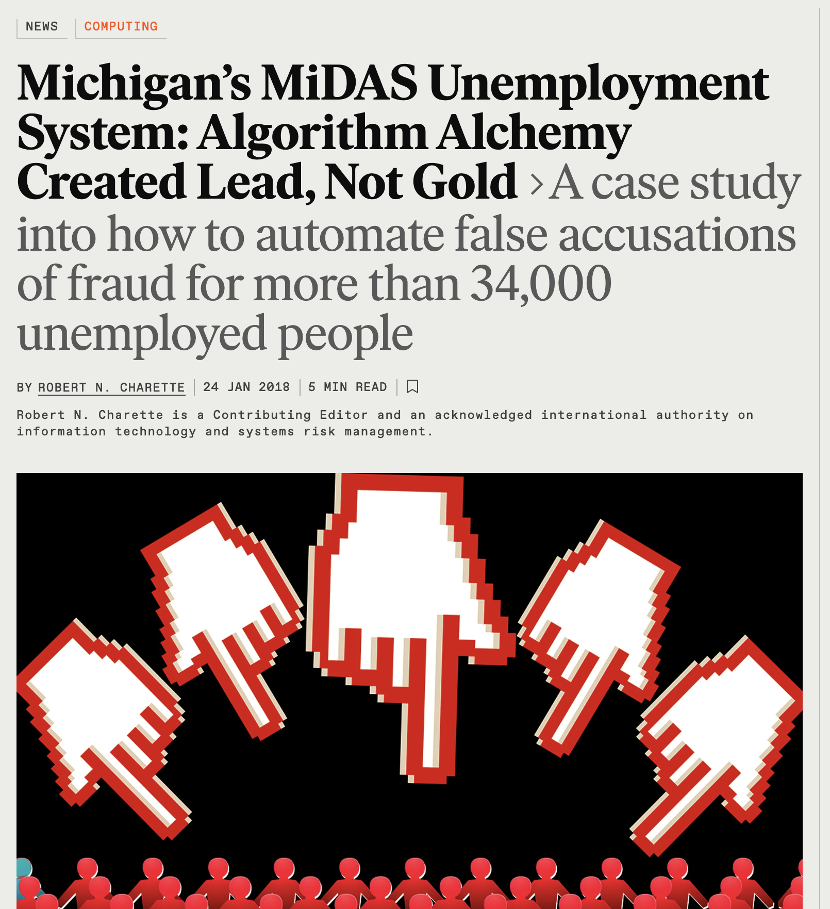
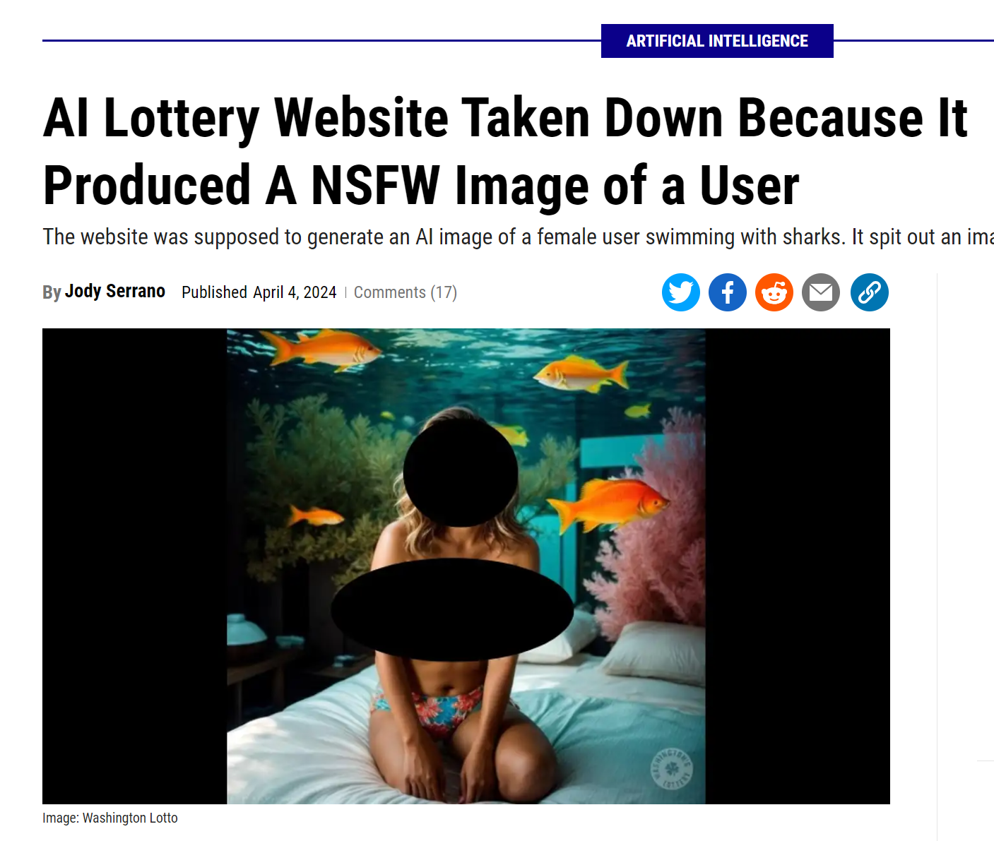

Slide 20
Notes:
Don’t jump to using AI if you don’t need to. Companies and organizations will lose billions and have reputational damage, legal liability if AI is adopted in the absence of a sound responsible AI governance strategy. Prioritization is a key component of responsible innovation. Who is your #1 priority in your organization?
The Consumer!

Slide 21
Services
STRATEGY
Values

Slide 22
AI Governance
Methods, Procedures, & Rules that shape how AI (machine learning) systems are Designed, Developed, Deployed, and Monitored.
Encompasses Ethical, Legal, & Technical considerations.

Slide 23
Responsible AI Principles (Values)
To guide and standardize efforts on quality, risk management, ethics and interoperability (at a minimum).
Appropriateness
Ethical & Social Responsibility
Non-Discrimination
Transparency & Accountability
Sustainability
Safety & Security
Notes:
Each of your organizations are defined by values and behaviors.
Appropriateness - Do you REALLY need to use AI? Do the costs (financial, ?
Ethical integrity involves upholding moral principles in all actions, particularly in the process of innovation. This can range from fair labor practices to user data protection.
Social Responsibility: The innovation process should aim to benefit society at large, including underserved or marginalized communities.
Inclusivity and Diversity: A commitment to including a diverse range of perspectives in the innovation process, which can lead to more robust and widely applicable solutions. Having this as a core value will inform behaviors that support development of products and services that meet the needs of your consumer!
Transparency and Accountability: Innovators should be open about their methods, the potential risks of their technologies, and be held accountable for the impacts.
Sustainability: Innovations should be created with long-term sustainability in mind, considering not just economic viability but also environmental impact.

Slide 24
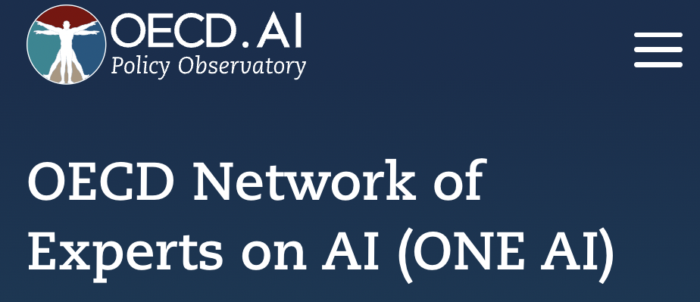
Intergovernmental & International Initiatives
Notes:
(jess)
OECD Recommendation on Artificial Intelligence, 2019
GPAI builds off of that, promotes research
G7 developing a code of conduct for AI
UN Roadmap for digital cooperation and new High-Level Advisory Body on Artificial Intelligence
TTC Joint Roadmap on Evaluation and Measurement Tools for Trustworthy AI and Risk Management
OECD Recommendation on Artificial Intelligence

Slide 25
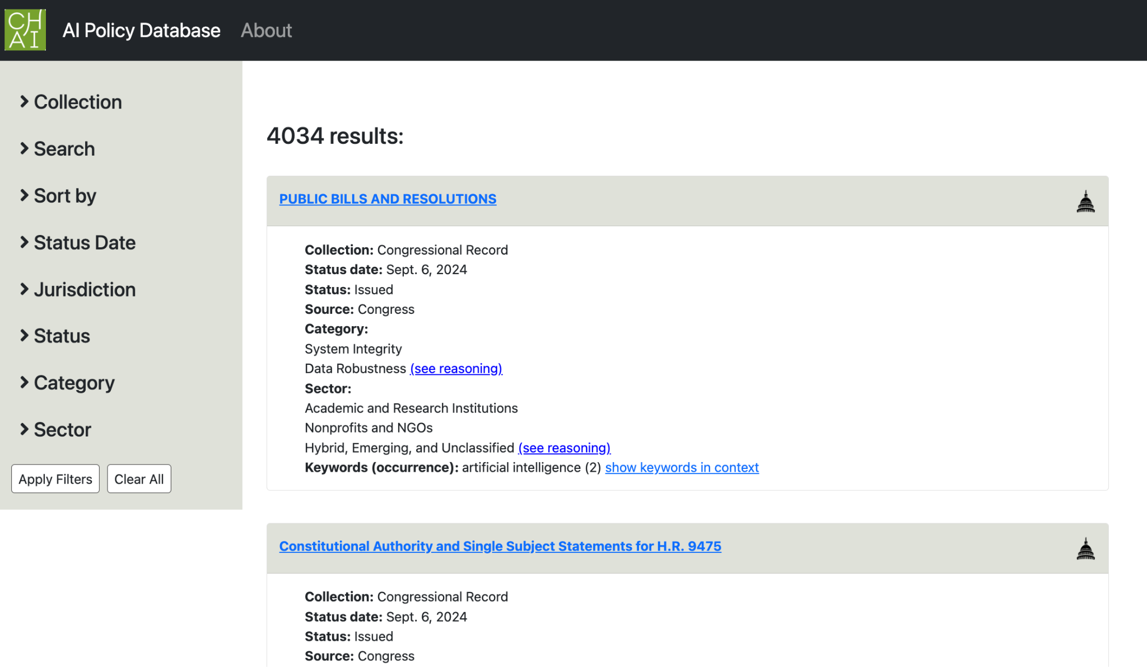
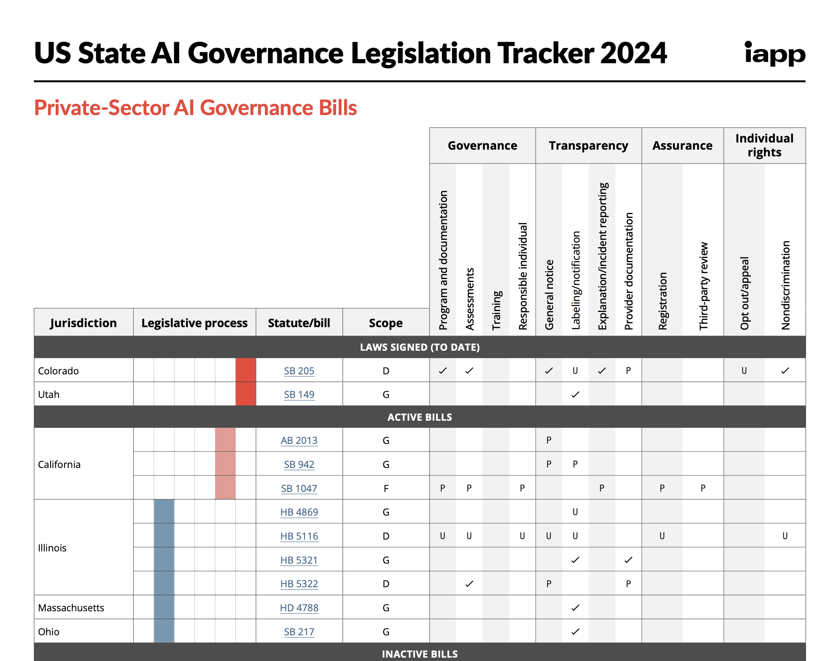
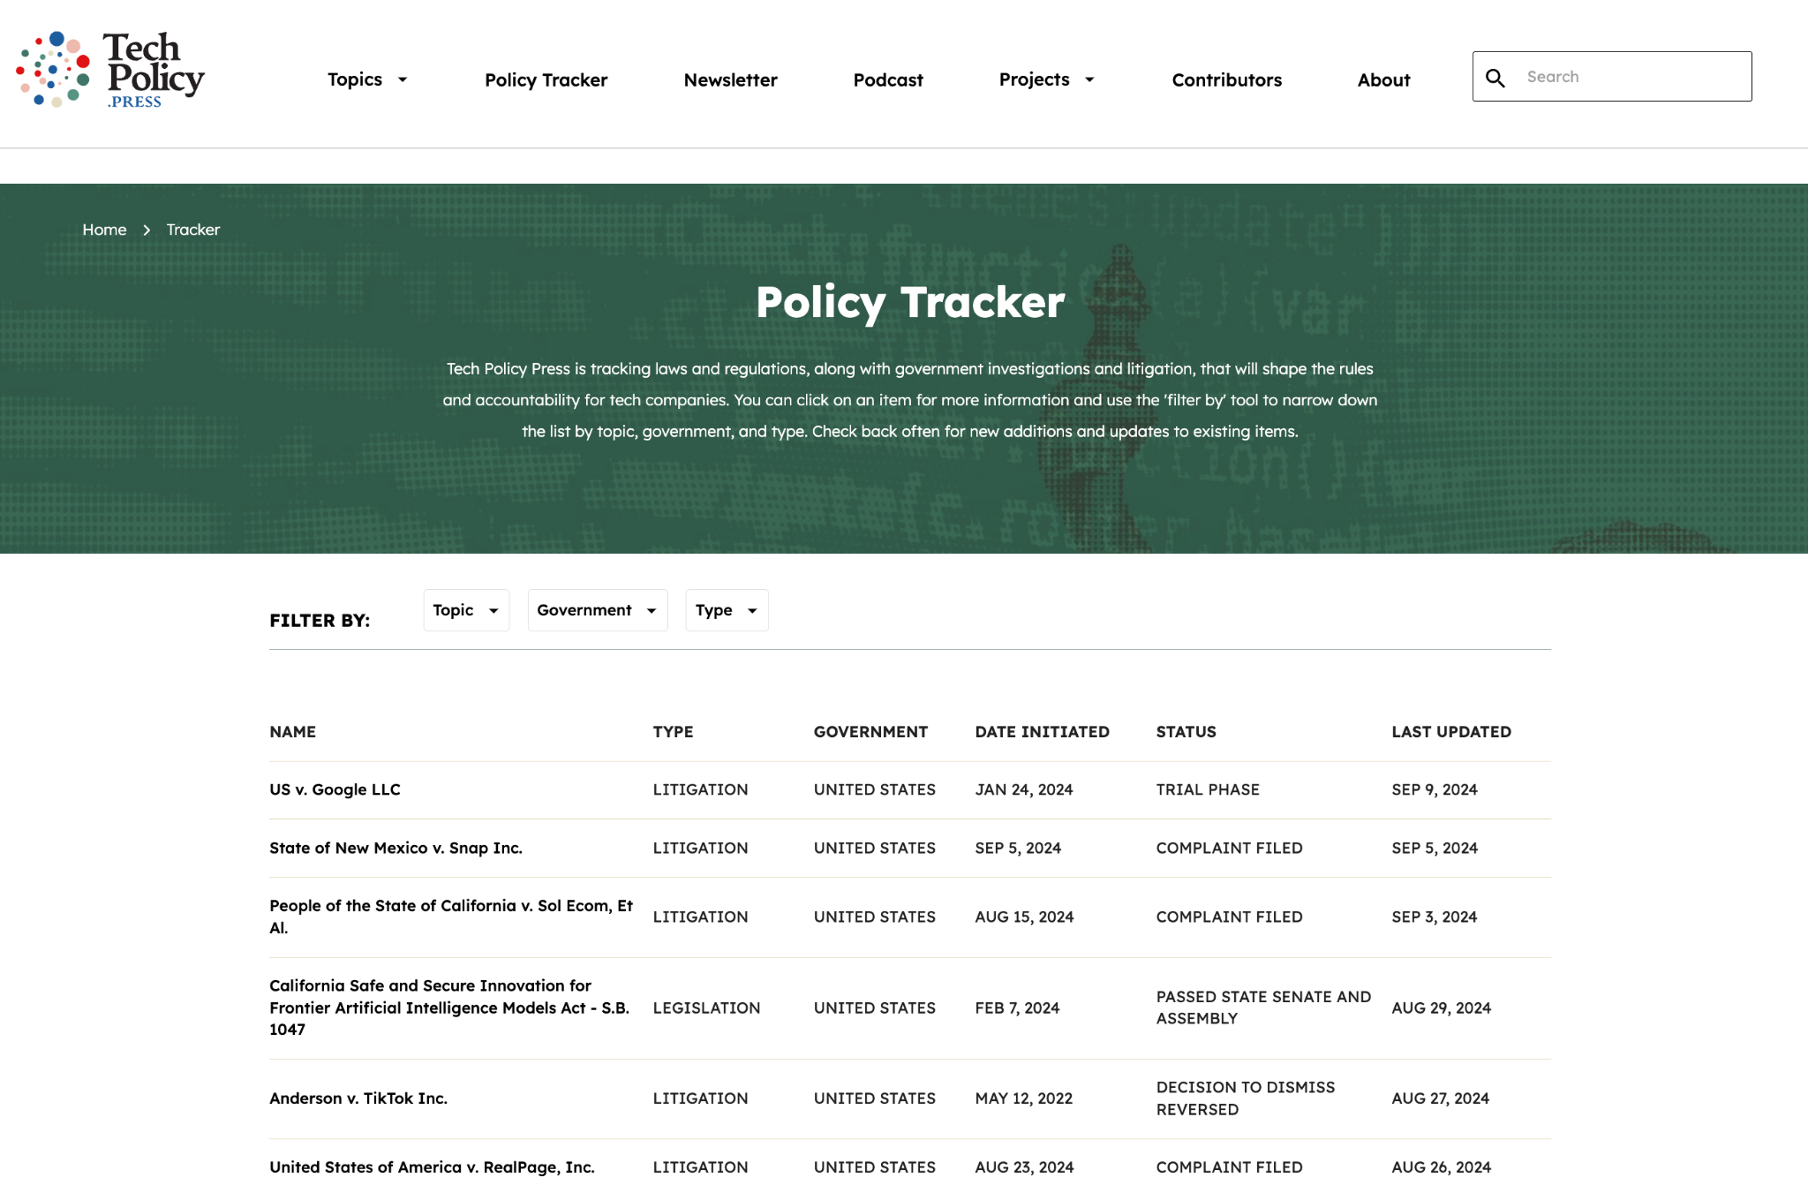
Federal & State AI Legislation Databases / Trackers
IAPP US State AI
Governance Legislation Tracker
CHAI AI Policy Database
Tech Policy Press Policy Tracker
Tech Better has compiled 16 AI law trackers

Slide 27
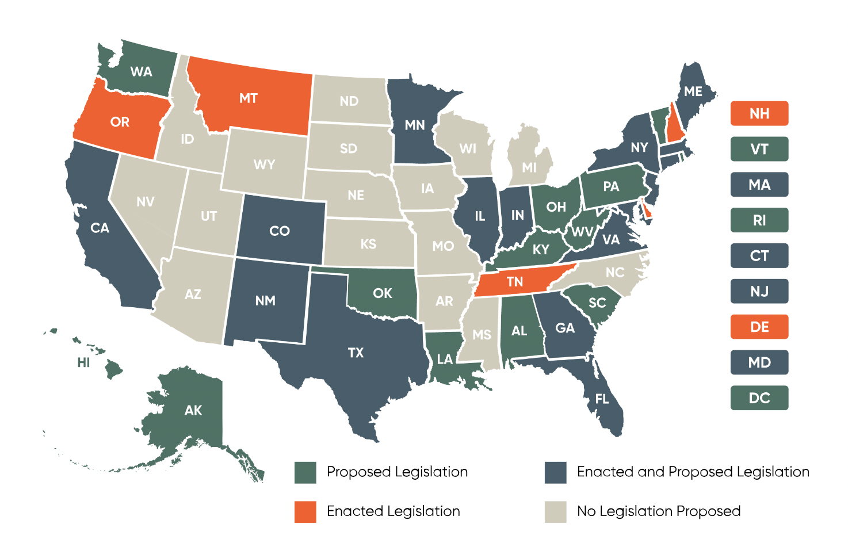
States AI Policy Landscape
Illinois - Biometric Information Privacy Act (BIPA)
New York - Commission on the Future of Work & NYC law on AI-enabled tools for HR
California & Washington - Executive Orders on GenAI
Utah - AI Policy Act (effective 1 May 2024)
Colorado - Colorado AI Act (effective 1 Feb. 2026)
BCLP Law, 2024
Notes:
https://www.bclplaw.com/en-US/events-insights-news/us-state-by-state-artificial-intelligence-legislation-snapshot.html

Slide 28
State AI Governance Themes
Data & privacy laws that address automated decision systems (ADS)
AI & elections (deepfakes)
Advisory boards/councils/task forces (harnessing AI)
Banning biometrics/facial recognition (privacy)
Workforce development (economy)
Non-discrimination & Auditing (legal obligations)

Slide 29
CALIFORNIA’S
AI GOVERNANCE STRATEGY

Slide 30
California AI-related bills
135 bills considered
AB-2930 & AB-331 (Bauer-Kahan) — Automated Decision-Making Technology: Developers and deployers must perform impact assessments and notify subjects of consequential decisions. If such results indicate discrimination, such algorithms are prohibited.
SB 892 (Padilla) — Public Contracts: AI Services: Safety, Privacy, & Nondiscrimination Standards: Businesses providing AI services to the state may be required to meet established safety, privacy, and nondiscrimination standards. This could include a review and possible overhaul of AI systems to ensure they comply with the new standards, affecting contracts with public entities.
SB-1047 (Wiener) - Safe and Secure Innovation for Frontier Artificial Intelligence Models Act: Regulate frontier models

Slide 31
California AI Policy Landscape
Relevant bills/laws/regs/orders/etc.
Bot Disclosure Law
California Consumer Privacy Act (CCPA) & California Privacy Rights Act (CPRA
Anti-Deepfake Law (sunsetted in January 2023)
SCR-17 Resolution expressing legislature’s commitment to the “Blueprint for an AI Bill of Rights”
Age-Appropriate Design Code Act
AB-602 - Depiction of individual using digital or electronic technology: sexually explicit material: cause of action

Slide 32
18 New California AI Laws
AI Education Initiatives (AB-2876 & SB-1288)
AI in Health Care (AB-3030 & SB-1120)
Robocalls Using AI (AB-2905)
Combatting Deepfake Non-Consensual Intimate Imagery (AB-1831, SB-926, & SB-981)
AI & Entertainment (AB-2602 & AB-1836)
Legal Definition of AI (AB-2885)
Election Deepfakes (AB-2655, AB-2839, & AB-2355)
Watermarking AI-Generated Content (SB-942)
Transparency in AI Training Data (AB-2013)
AI Risk Management (SB-896)
Privacy & AI (AB-1008)

Slide 33
Executive Order (EO 12-23)

Slide 34
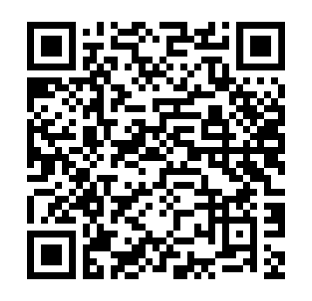

Slide 35
De Jure → De Facto

Slide 36
De Jure → De Facto
De Jure De Facto

Slide 37
State AI Governance Practices & Tools
01
02
03
SUBSTANTIVE
FRAMEWORKS
STRUCTURES
TOOLS
Impact/Risk Assessments
Model Cards & Datasheets
Technical Controls (audits/monitoring, guardrails)
Contracts / Terms of Use
Interventions in Software Development Lifecycle
Training
Product Reviews
Audits & Reporting
Sandboxes
Governance Strategy
Risk Management (NIST AI RMF)
Standards (ISO, IEEE)
Certifications (IEEE CertifAIed, IAPP AI Governance Training)
Principles / Values
Maturity Models
Roadmaps
Advisory Council (Internal or External)
Hybrid Internal / External Advisory Council
Review Boards
Communities of Practice
Ad hoc Working Groups
Traditional Organizational Departments
Chief Executive Special Projects

Slide 38
Services
STRATEGY
Values

Slide 39
Principles & Risk Mitigation Strategies (non-exhaustive)
Appropriateness
No-Go Strategy: Determine whether and type of machine learning (ML) is necessary. Can risks be managed to enable benefits? Is my org capable of executing?
Ethical & Social Responsibility
Human-in-the-Loop: Maintain human oversight for critical AI decision-making systems. How will people review/attest?
Non-Discrimination
Bias Detection & Management: Implement testing & audits to identify & manage biases. What types of bias(es) are a risk? How can the bias(es) be managed?
Transparency & Accountability
Algorithmic Transparency: Publicly disclose what type(s) of ML you’re using, data used, and how AI decisions are made.
Sustainability
Environmental Considerations: Will use of large ML models use immense energy and water? Is a simpler model as effective?
Safety & Security
Data Privacy Protections: Strict adherence to privacy laws (e.g., GDPR, CCPA) and privacy-by-design. Are you practicing data minimization? Purpose-use specification?

Slide 40
Common State AI Governance Tools
Risk & Impact Assessments
NIST AI Risk Management Framework (Profiles & Self-Reports)
Sandboxes
Algorithmic Auditing & Continuous Monitoring
NIST AI Risk Management Framework (Profiles & Self-Reports)
IEEE CertifAIed
IAPP AI Governance Certification
Internal & External Red Teaming/Auditing
Sandboxes
Standards
IEEE
ISO
CEN-CENELEC
Public Disclosure & Accountability
AI Inventory
Harm Reporting Mechanism

Slide 41
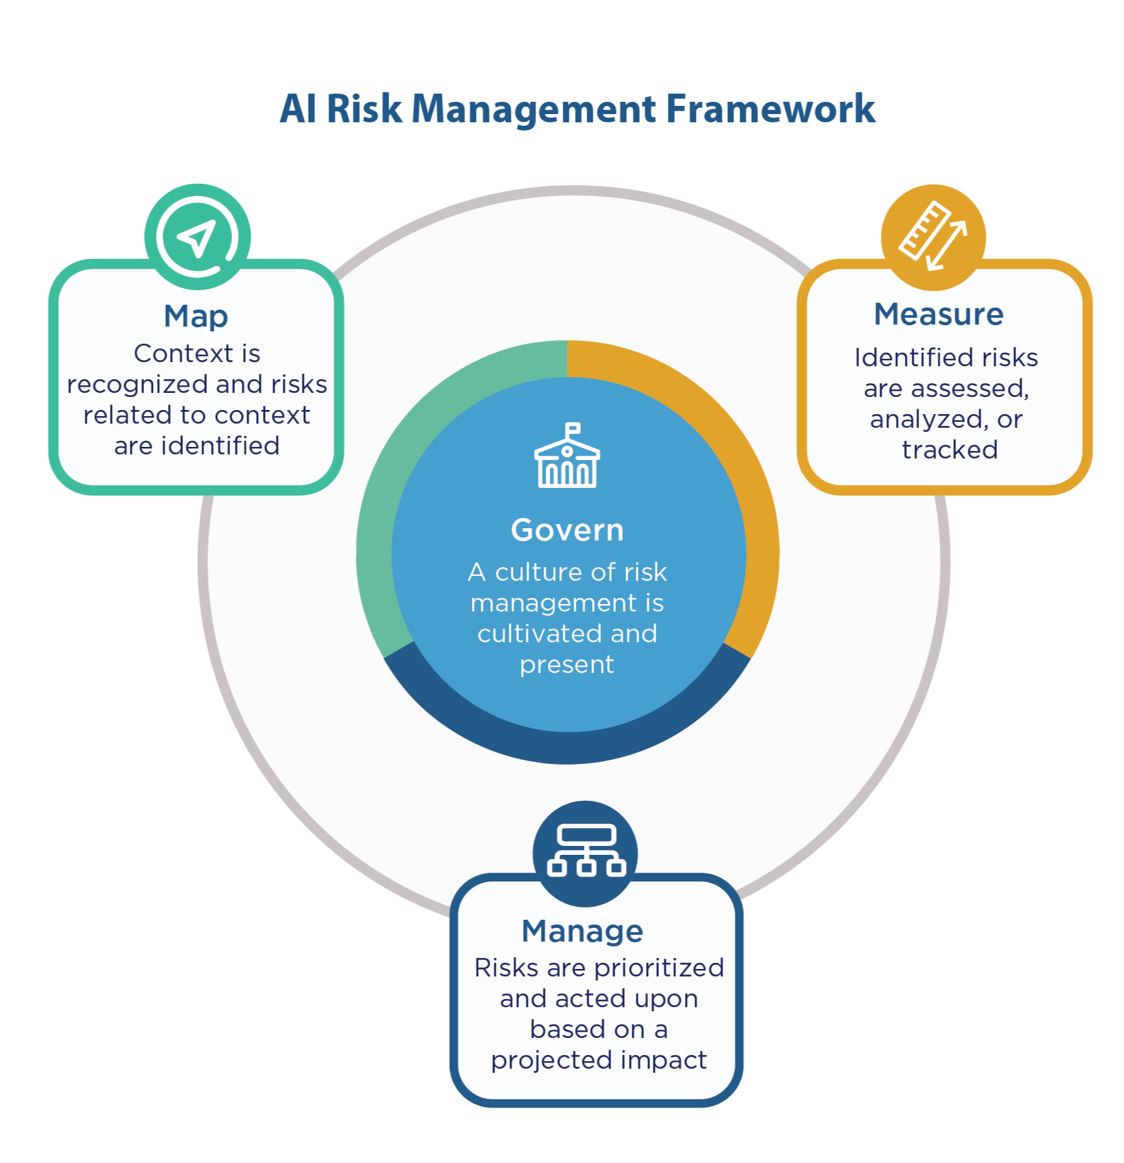
RISK & IMPACT ASSESSMENTS

Slide 42
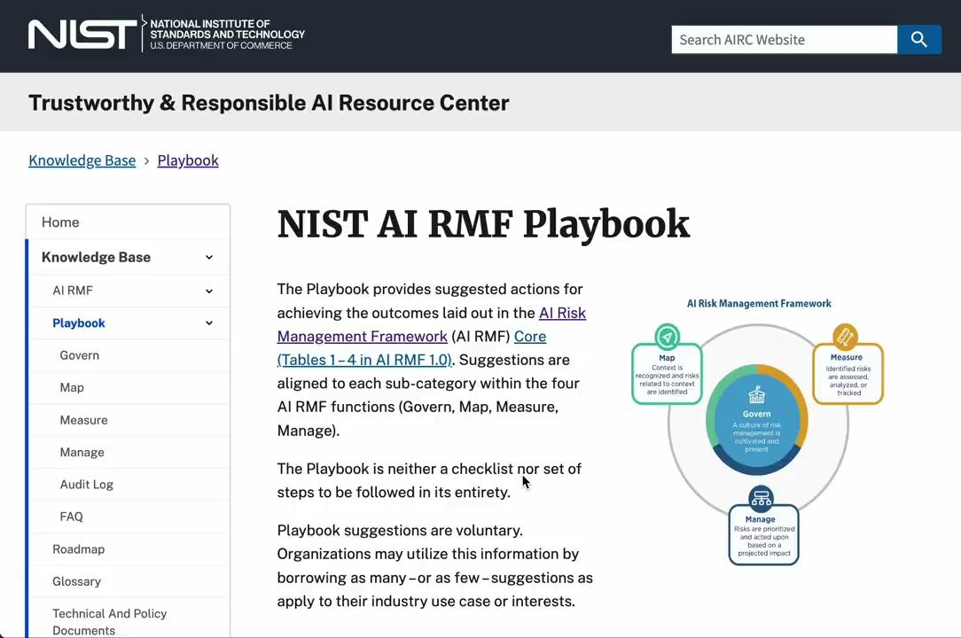

Slide 43
Third-party Auditors, Evaluators, Licensors, Certifiers
Auditors
ORCAA
Parity AI
Evaluators
Credo.ai
ARC Evals
Licensors
Responsible AI Licenses (RAIL)
Certifiers
Responsible AI Institute

Slide 44
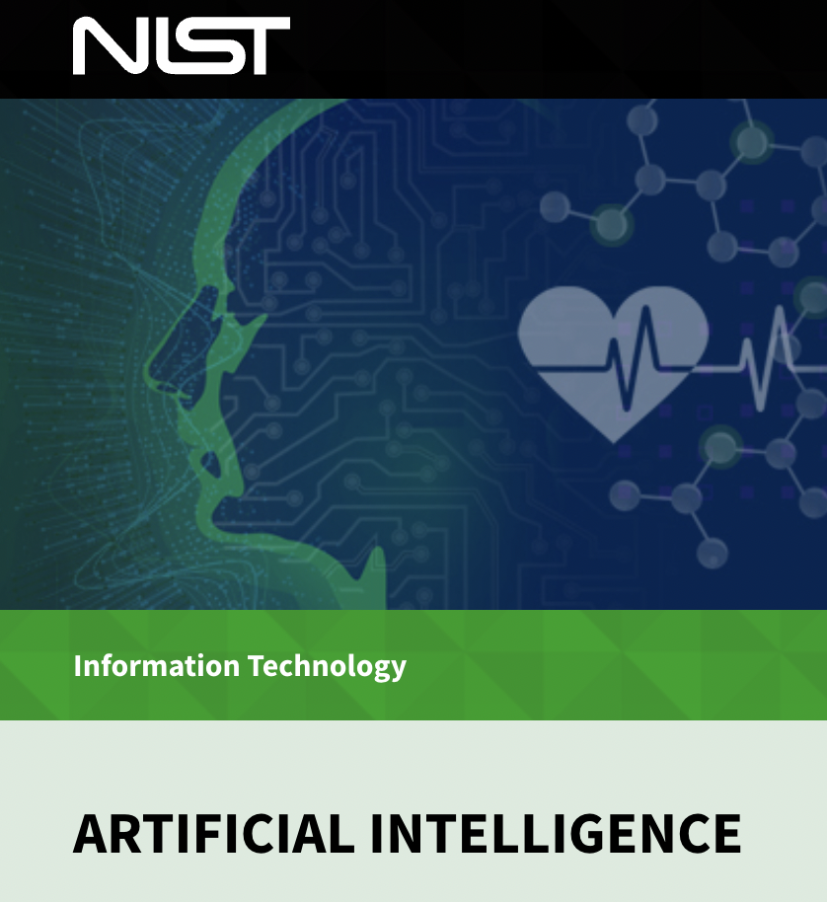
ROLE OF AI STANDARDS & GUIDELINES

Slide 45
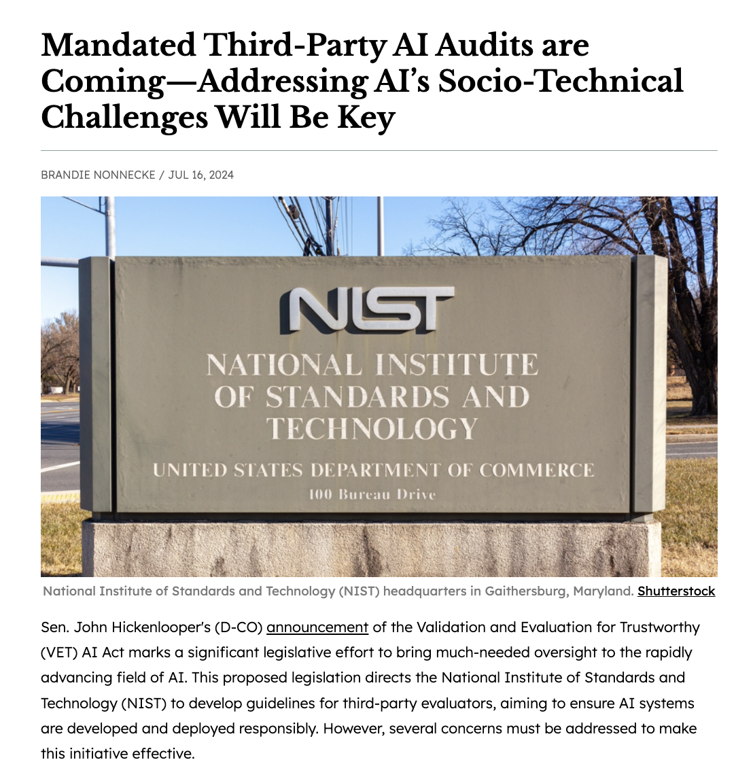
VET AI Act
Validation and Evaluation for Trustworthy (VET) AI Act

Slide 46
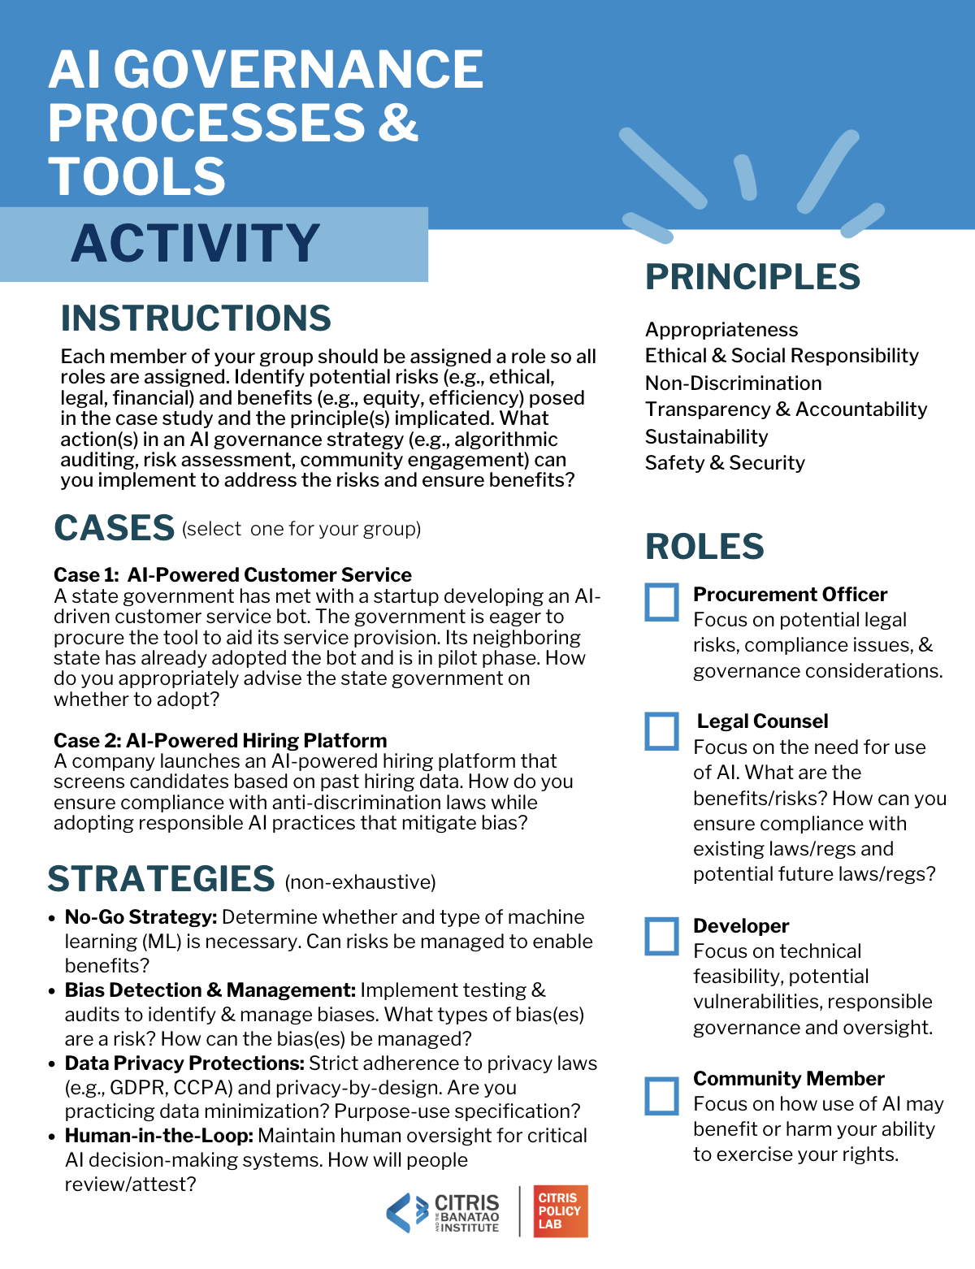
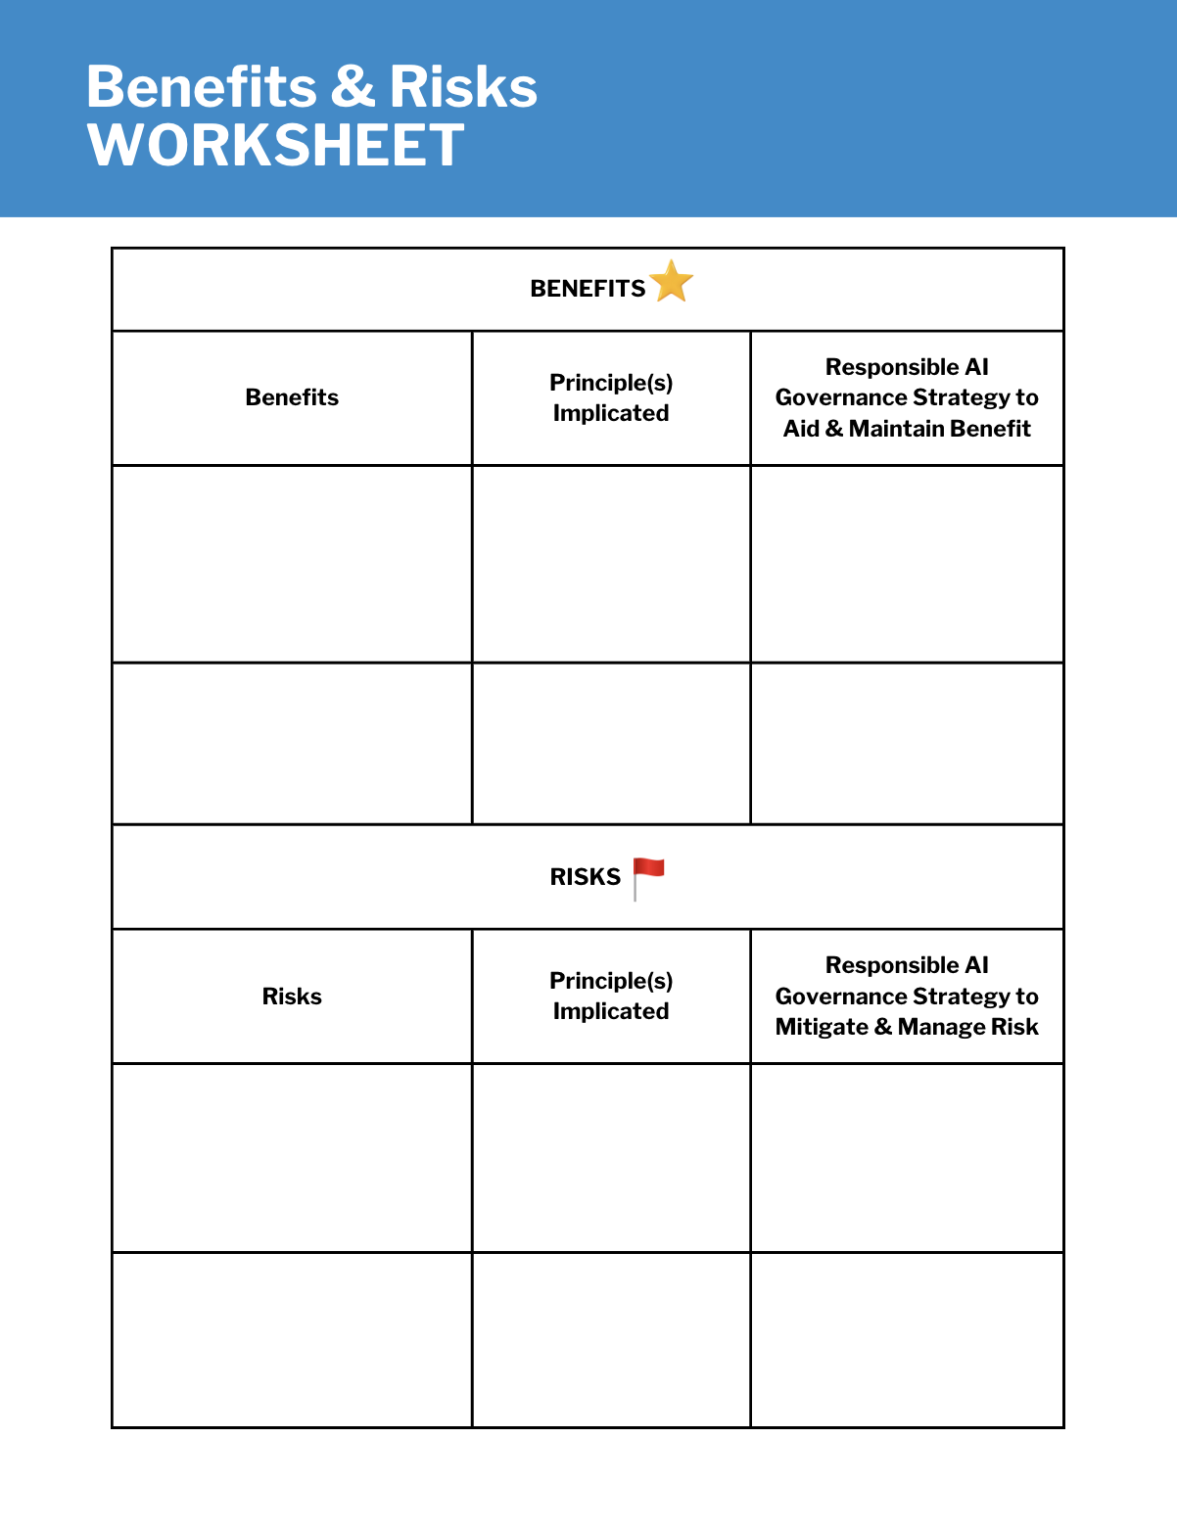
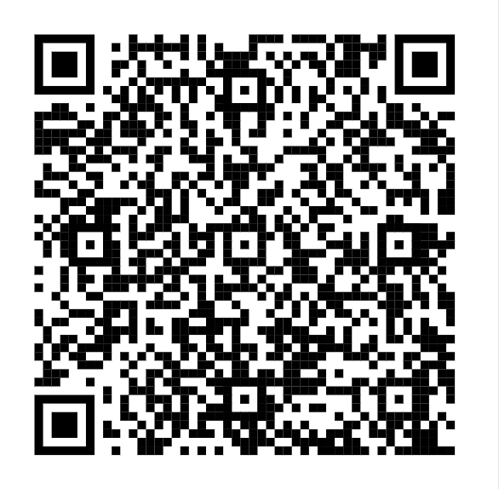

Slide 47
REPORT OUT
Challenges?
Surprises?
Tensions?
Synergies?

Slide 48
CONTACT
Brandie Nonnecke, PhD
Director, CITRIS Policy Lab
Assoc. Research Professor, Goldman School of Public Policy
Faculty Co-Director, Berkeley Center for Law & Technology
nonnecke@berkeley.edu | @BrandieNonnecke | @TecHypeShow

