Slide 1
Climate Change and Risk
U of California Berkeley
March 1, 2021

Slide 2
Outline
Why recent work in economics (integrated assessment markets) underestimates urgency and scope of what has to be done, and lead to too low a price of carbon
Children’s suit to protect interests of future generations
Optimal policy responses

Slide 3
Insights from 1995 IPCC Report

Slide 4
Insights from 1995 IPCC Report
Unique characteristics of the “problem”:
  large uncertainties (scientific and economic),
  possible non-linearities and irreversibilities (climate tipping points)
  asymmetric distribution of impacts geographically and temporally,
  the very long time horizon,
  the global nature
Application of the precautionary principle provides rationale for «action beyond no regrets»

Slide 5
Subsequent results
Most devastating effects are associated with weather variability and extreme events
  Floods
  Hurricanes
  Droughts
  Fires
  Frosts
New research is that these may even trigger volcanic activity
Large health consequences
Large economic consequences

Slide 6
Responses
Legislative—regulations, carbon pricing, green investment
Judicial—”forcing” governments to take more action
Critique of strong actions: large economic consequences of doing too much
  IAM suggests “optimum” entails 3.5 degrees C
  Corresponds to social cost of carbon that is relatively low
    Key policy issue just now
Critique of the critique
  Large economic consequences of not doing anything—and especially large risks
  GDP not good measure—doesn’t take into account environmental degradation—false trade-off
  IAM models often exaggerated trade-offs—overestimated costs/underestimated benefits

Slide 7
Underestimating urgency and scope of what has to be done
  Intertemporal representative optimization model
    Introduces an environmental variable in production function
    Climate change can do “damage”—shifts production function down
      Typically don’t take into account destruction of capital stock
    Climate change affected by fossil fuel usage
    Curbing fossil fuel usage reduces GDP today
    Key issue intertemporal trade-off: low GDP today, higher GDP tomorrow
    Finds optimal solution
    Conclusion: optimum to have 3.5 degree C. change; curbing climate change more than that not optimal
  Numerous deficiencies in models, related to assumptions—model dangerous, and been used by climate skeptics to limit action

Slide 8
Some flaws in the models
Many questionable details in modeling (e.g. damage functions)
  Results not robust
Reflects excessive confidence in markets—ignoring pervasive market failures
  Assumes that, apart from the environmental externality, the economy is efficient
    So if we “optimally correct” distortion through, say, carbon tax, the economy will be efficient

Slide 9
Flaws…
Poorly designed models
  Not incorporating advances in climate science, economics, and finance
    Showing importance of non-linearities, non-convexities in both climate model, economic models
      Which can give rise to systemic fragility
      Climate change which can increase disproportionately with greenhouse gas concentrations
      Damage functions which increase disproportionately with climate change
        Importance of climate variability (over space and time)
        Large destruction to wealth—reconstruction shows up in GDP, but welfare decreased

Slide 10
Inadequacy of standard integrated assessment models (continued)
Inadequate treatment of risk
  Often focusing on “central case”
  Seldom incorporating full analysis of implications of fat-tailed distribution
    Expected utility may not even be defined
  And the fact that social marginal utility of income will be high precisely in those states of nature where climate change and its adverse consequences are large
  Large losses in bad states combined with risk aversion means taking strong actions now is far more desirable than it would be in the absence of risk
    Effective discount rate lower (higher social cost of carbon)

Slide 11
Normative framework needs to change
Standard model sets policy to maximize intertemporal utility, uses that model to assess the social cost of carbon, and uses that to set appropriate price intervention
  Defining “social cost of carbon”
Standard approach ignores consequences of fat-tailed distributions (Weitzman)
  Expected utility isn’t even defined (equals minus infinity)
  Implies high (infinite) social cost of carbon
Not a complete ordering
  Implies optimization approach is questionable
  Getting a complete ordering is even more difficult in the context of making social decisions
  But consensus on some things can still be reached
  That is what the international community is done

Slide 12
Discounting
Key to policy—how to evaluate the benefits of reducing carbon emissions
Benefits will be felt largely in future
  Using a 7% discount rate says we should pay essentially no attention to future generations
  IAM models suggest that since we can get a 7% return on investment, better not to curb output today, put money into productive investment yielding 7%, and compensate future generations for the environmental damage

Slide 13
Failures of standard normative approach
Standard approach (using a dynastic intertemporal utility function, as if there is a single infinity lived individual, rather than explicitly taking account the effects on later generations) assumes that we can (and will) costlessly compensate future generations for environmental damages
  Thus the societal maximization problem is identical to that of the individual—except the individual doesn’t take into account environmental externalities
  Such redistributions typically don’t occur
  For the most part, standard approach doesn’t adequately take into account intragenerational distributive effects
    Implicit assumption that government can and does costlessly undo any adverse effects

Slide 14
Risk and discounting
Standard approach confuses risk discounting with time discounting
  Greater uncertainty may mean that we should take greater precautionary actions
    Increasing discounting because of risk says we should pay less attention to future
    Correct approach is to calculate certainty equivalents, and then to evaluate impacts on different generations at “intertemporal social discount rate”
  And ignores the fact that in those states of nature where damages are high, we will be worse off, have less resources to adapt to climate change, may not be able to make compensation
    This alone implies a low (possibly negative) discount rate (Arrow, Stiglitz, et al.)
  How we value income to future generations is an endogenous variable, a function of what actions we take today
    Can’t just be read off the market rate of interest
    But if we were to read it off the market rate of interest, real safe interest rate has been negative—and previous analysis says appropriate discount rate taking into account risk should be smaller

Slide 15
Much else is left out of model
Standard approach doesn’t put any (reasonable) assessment of the value of life
  If a fraction v of the population loses their lives every year because of climate change, if the value of a life is m times per capita income, expected loss on this account alone is mv. Reasonable estimates of this imply high values for the social cost of carbon
  Just one example of many of important costs that have been ignored
    Loss of biodiversity
Endogenous and changing preferences and technology

Slide 16
Two key consequences of these model failures
Failure to recognize the urgency and scope of what has to be done
  Some have even suggested that we shouldn’t be worried so long as temperature increase is less than 3.5 degrees C.
Reliance of simplistic instruments—just price intervention

Slide 17
Juliana v. United States

Slide 18
II. Juliana v. United States
Juliana, et al. v. United States of America, et al. is a climate justice-based lawsuit filed in 2015 that is being brought by 21 youth plaintiffs against the United States and several of its executive branch positions and officers
The plaintiffs, represented by the non-profit organization Our Children's Trust
  The lawsuit asserts that the government violated the youths' rights by encouraging and allowing activities that significantly harmed their right to life and liberty, and sought the government to adopt methods for reducing greenhouse gas emissions
  Brought under provisions of Constitution and Comon Doctrines
    The public trust doctrine is the principle that the sovereign holds natural resources in trust for public
  Key issue is intergenerational equity
The case is under appeal at the Appelate level

Slide 19
2017 Report of the High-Level Commission on Carbon Pricessupported by staff of the International Bank for Reconstruction and Development/ International Development Association (The World Bank). Chaired by Lord Stern and Joseph Stiglitz (referred to as th Stiglitz-Stern Report)

Slide 20
III. Global Carbon Pricing Commission (Stiglitz-Stern Commission)
The purpose of Commission: to explore ways of achieving Paris goals, including explicit carbon pricing options and levels that would induce the change in behaviors, including investment in infrastructure, technology, plant and equipment, needed to deliver on the temperature objective of the Paris Agreement of “well-below 2C,” in a way that fosters economic growth and development as expressed in the Sustainable Development Goals.

Slide 21
Key issues
Extent of reliance on price interventions
  Natural to think of price interventions—close gap between social and private returns
  Will explain why that may not be optimal
If there is a price intervention, what should be level and time profile of prices?
What other policies should be pursued?

Slide 22
Carbon pricing is necessary but insufficient
From Stiglitz 2019 Eur. Econ Review

Slide 23
Carbon pricing is necessary but insufficient
Need for large public and private investments
Need for regulations to guide the economy and stimulate innovation
The larger the investment, and the better the regulations, the lower the carbon price required to achieve the Paris goals.
From Stiglitz 2019 Eur. Econ Review

Slide 24
Market imperfections interact—and climate change entails aspects of all
Economies with imperfect risk markets and imperfect information are essentially never (constrained Pareto) efficient (Greenwald-Stiglitz)
  Important role for government interventions
  Interventions should not be limited to simple price interventions
  Weitzman derived conditions under which quantity regulations were superior
Capital market imperfections are pervasive
  And can lead to underinvestment in certain key areas
  Likely to be especially important in investments in areas where price signals are not working (climate change)
  Capital markets and firms are short sighted
    Partly as a result of problems of corporate governance

Slide 25
The rules of the economic game matter
Markets don’t exist in a vacuum
  The rules affect both efficiency and distribution
Key rules affecting climate change include: corporate governance, disclosure rules, bankruptcy rules, rules governing fiduciaries
  Many of the rules were designed to address market failures—but some were imperfectly designed
    Some of these rules create a bias against doing anything about climate change
  Market does not have appropriate incentives for disclosure
    Need disclosure rules concerning climate risk
    But rules have to reflect systemic risk and transitional risk
  Conflicts of interest are pervasive
    But fiduciary standards were often set in wrong way, focusing on short term financial returns—now need to get reversed to look at long run consequences (pension funds, endowments etc. not allowed to look at climate risk)

Slide 26
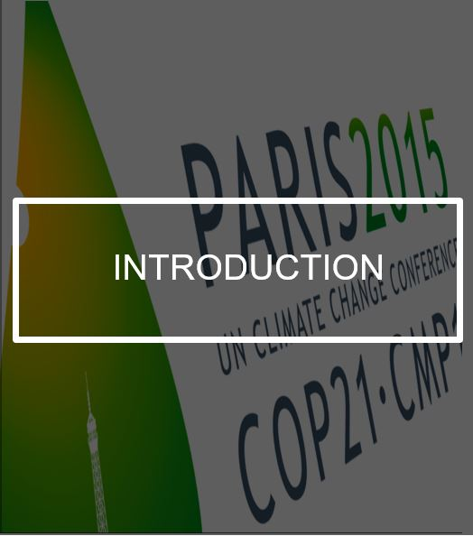
The required changes imply structural change, learning, experimentation, and technological changes, and involve large uncertainties.
Climate policies, if done well, are consistent with growth, development and poverty reduction.
Potentially a powerful, attractive and sustainable growth story with more friendly cities, robust agriculture and stronger ecosystems.

Slide 27
In short…
Addressing climate change is feasible
Won’t cost that much
Likely will be good for the economy
And especially so if we use the right metrics

Slide 28
Climate policy packages
Achieving the Paris objectives will require all countries to implement climate policy packages.
  Packages include pricing, regulations, and investments
  Policies should be designed to induce learning and respond to new information
  should take into account non-climate benefits, particularly reduced pollution, local context, and political economy
The design of country policies will vary and take into account national and local circumstances. Lower-income countries may choose lower carbon prices as complementary resources may be cheaper and distributional issues less easy to handle (contrary to principle of single price: necessary part of political compromise, and required to address distributive consequences)

Slide 29
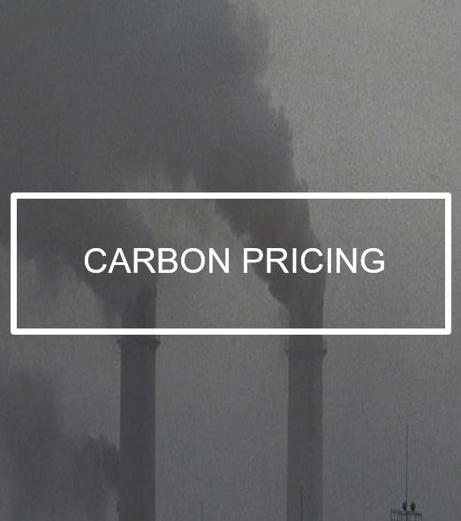
A well-designed carbon price is an indispensable part of a strategy for reducing emissions in an efficient way.
GHG emissions can be priced explicitly with a carbon tax or cap-and-trade systems.
Reducing fossil fuel subsidies is another essential step toward carbon pricing.
Explicit carbon pricing can be usefully complemented by shadow pricing in public-sector activity and internal pricing in firms.

Slide 30
Carbon pricing
Requisite prices need to be much higher than current prices but are eminently affordable
Taking into account what we’ve learned about climate change in last few years, a carbon price of around $100/tCO₂ by 2030 is required
These price ranges assume that the pricing policy is complemented with well-designed policies and actions, such as efficiency standards, research and development, city design, networks…, and a supportive investment climate. In the absence of these elements, the carbon-price range required is likely to be higher.
These carbon prices are eminently affordable, will induce changes in energy prices smaller than those that have been experienced in the past

Slide 31

Carbon pricing alone likely will not be sufficient to induce change at the pace and scale required for the Paris temperature target—or be the most efficient/equitable way to do so.
Adopting other cost-effective policies – with strong emphasis on other, related, market failures and the dynamics of change – can mean that a given emissions reduction could be induced with lower carbon prices.
Such policies include:
investment in low-carbon infrastructure,
Regulations, efficiency standards, urban planning,
groundwork for renewable-based power generation,
land and forest management,
fostering R&D investment,
financial instruments

Slide 32
Examples of regulatory interventions
No coal electric generating plants without carbon storage
Emission standards for cars
Cement standards
Embraces large fraction of emissions
    But still leaves much out
Many of these standards/regulations are easy to enforce

Slide 33
Deviations from Efficiency
Economists criticize regulations because they result in deviations from efficiency (single “price” for carbon in all uses, in all places)
But most countries have deviated from relying on a single price by subsidizing (e.g. renewables) or regulations
How do we explain this?
Reducing distributive burden—can be large changes in prices for small allocative effects
  Offsetting distributive effects costly, may be impossible
  Even if on average rich individuals use more carbon than poor, there are some poor individuals for whom a carbon tax has very adverse effects
  If no well managed, can give rise to “yellow vest movement”
Correcting other market failures
    (i) coordination failures
    (ii) induced innovation
    changing preferences (consumption externalities)
    High levels of uncertainty, imperfect risk markets

Slide 34
Adaptability
Carbon prices and other aspects of climate packages (e.g. regulations) will need to be adjusted over time, particularly upward if existing prices fail to bring about the required changes
Important research question: design of optimal sequential policies, revisions as new information becomes available

Slide 35
VI. Concluding Remarks
World is engaged in a risky experiment
  Science has provided us with an increasingly clear and bleak view of what will happen if we don’t change “business as usual.”
  Imperative that there be reductions in emission levels
  But imperative that it be done in ways where the burden of adjustment is equitably shared
Will require new economic model—changed patterns of consumption and innovation
  We have treated two scarce goods (air and water) as if they were free
  Charging for them will lead to large changes in prices
    With possibly large distributive consequences
    With large changes in our economic and social systems

Slide 36
Concluding Remarks
Global warming is a long-run problem
But it is a problem which needs to be attacked now
  Delay will increase the costs—less expensive to not add greenhouse gases to atmosphere than to remove them, once there
    Interesting models focusing on asymmetries of costs and optimization in presence of uncertainty
  Delay in agreeing on equitable burden sharing will increase the likely inequities which will arise
    Inequities within countries, across countries, and across generations
    Current approach unduly discounts value of future generations

Slide 37
Cost of responding to climate change—if we do it efficiently—is relatively small, and much smaller than the cost of not responding
  But certain sectors and firms will be hurt
    Coal
    Large car manufacturers
  But new industries will also be created
    Firms that respond to new opportunities creatively will do well

Slide 38
Need for global cooperation—and enforcement
Global climate change is a global issue, that has to be addressed globally
  Would be good if necessary cooperation could easily be achieved
Will need to impose cross-border taxes
  Such taxes are WTO consistent (shrimp-turtle case)
All countries need to cooperate in imposing sanctions against any country failing to cooperate
Risks of climate change are simply too large to let any single individual or country put the entire planet in danger

Slide 39
Climate change poses a rich and essential research agenda
Economics and finance disciplines have given short shrift to climate science—in spite of its importance
Requires a multiple disciplinary approach
Climate change challenges conventional thinking in economics and finance, which has assumed rational expectations, well functioning markets, and ignored important non-linearities and non-convexities
Climate change is marked by a high level of risk and uncertainty
Interesting and important issues in political economy
  How to get better buy-in from citizens, avoid “yellow vests”
  How to induce behavioral change
Advances in our ability to analyze climate change will have important collateral benefits, e.g. in other areas marked by high levels of uncertainty and risk, such as macroeconomics

