Slide 1
Many possible dimensions of
law clerk diversity
Educational background
Viewpoint
Professional experience
Sexual orientation
Socioeconomic background
Disability status
Religious belief/affiliation
Veteran status
Geography
Gender
Interests and affiliations
Race/ethnicity

Slide 2
Current snapshot of federal judiciary
739 active judges
488 men (66.0%)
536 white (72.5%)
251 women (34.0%)
94 African American (12.7%)
71 Hispanic (9.6%)
29 Asian American (3.9%)
1 American Indian (0.001%)
Source: https://www.fjc.gov/history/judges/search/advanced-search

Slide 3
Demographics of SCOTUS law clerks
487 law clerks hired from 2005 to 2017
66% men
85% white
34% women
4% African American
1.5% Hispanic
9% Asian American
Source: Tony Mauro, National Law Journal

Slide 4
What we don’t know
Basic demographic data on federal law clerks
Preference formation and self-selection among law students
Advising, mentoring, and selection practices among law schools
Recruiting and hiring practices among judges

Slide 6
Source: National Association for Law Placement

Slide 7
Source: ABA; USNWR

Slide 8
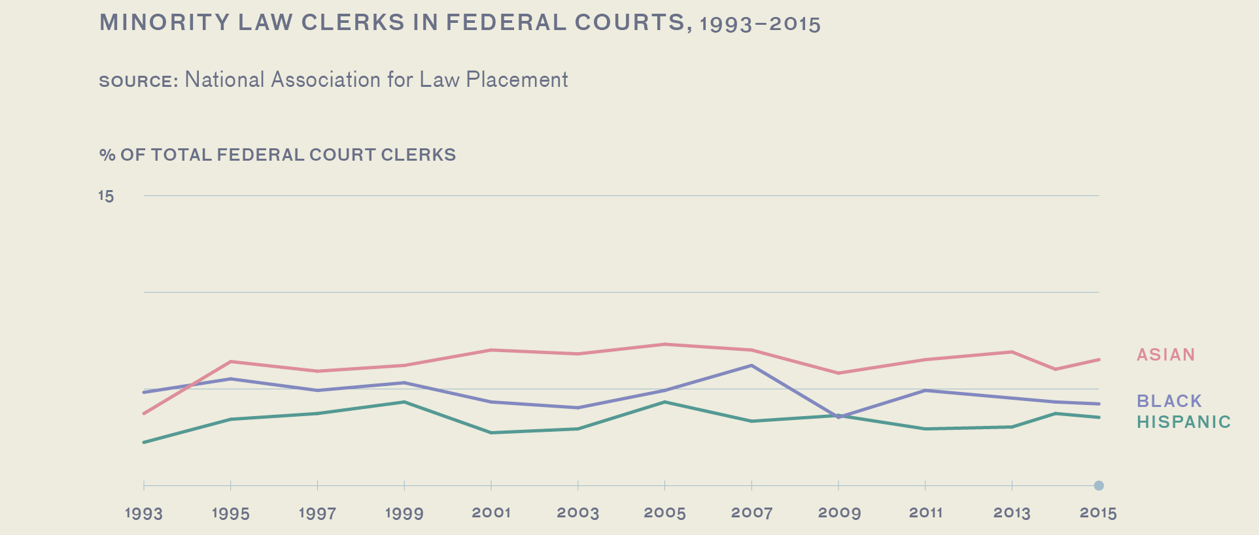
10
5
Source: A Portrait of Asian Americans in the Law (2017)

Slide 9
Source: ABA; USNWR

Slide 10
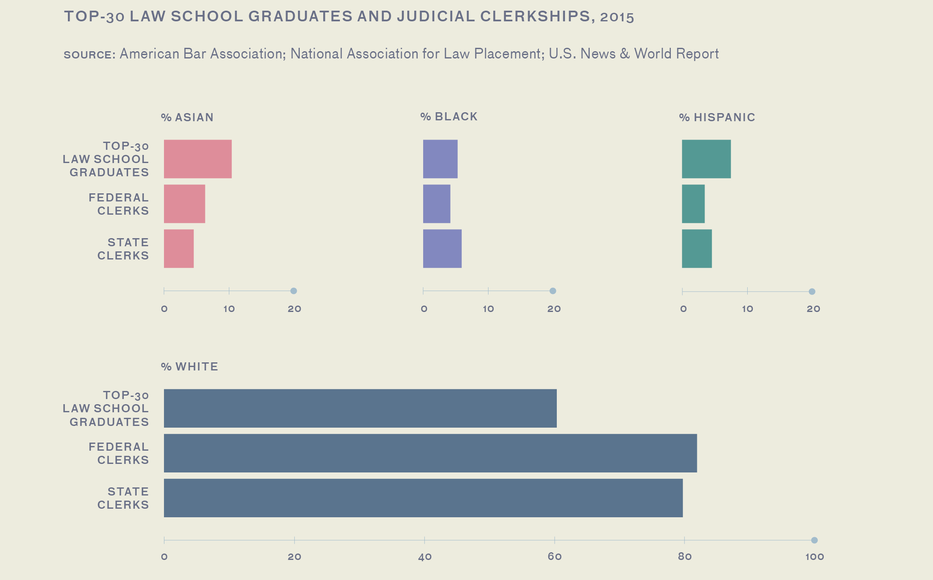
Source: A Portrait of Asian Americans in the Law (2017)

Slide 11
LAW SCHOOL MENTORSHIP & LIKELIHOOD OF CLERKING
15%
of respondents with
0 mentors but who did not seek them
obtained
judicial clerkships.
20%
of respondents with
0 mentors but who sought them
obtained
judicial clerkships.
19%
of respondents with
1 or
2 mentors
obtained
judicial clerkships.
29%
of respondents with
>2 mentors
obtained
judicial clerkships.
Source: A Portrait of Asian Americans in the Law (2017)

Slide 14
Study design
Descriptive and constructive
Confidential, anonymous, secure
High premium on candor and trust
Collaborative, respectful of participants’ time

Slide 15
Sample selection
Minimum 5 years of service
Combined random (20) and nonrandom (20) samples
Oversampling of women and minorities
Diversity by appointing President, age, years of service, geography, feeder status, professional background, law school attended

Slide 16
Methods
Survey instrument: constructed response and selected response items
Individual interview: uniform protocol
Comparability concerns

