Slide 1
Who are you calling a pirate? Willful infringement and enhanced damages
The Role of Opinions of Counsel
Gabriel Ramsey
Partner, Crowell & Moring LLP

Slide 2
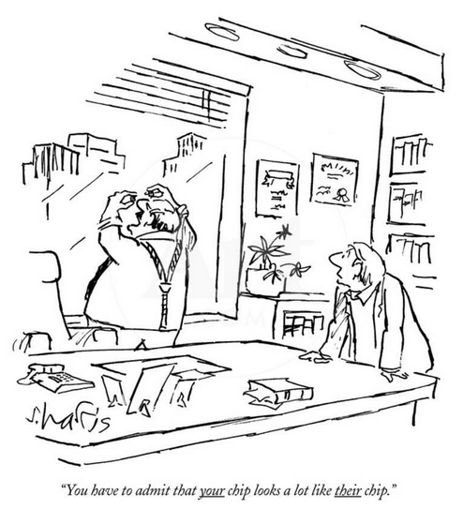
Underwater Devices (1983): Traditional Federal Circuit Rule
Affirmative duty of due care includes “the duty to seek and obtain competent legal advice from counsel before the initiation of any possible infringing activity.”
“Unreasonable” opinion = negligent
e.g. Stryker Corp. v. Davol, Inc., 234 F.3d 1252 (Fed. Cir. 2000)
Dialed back over time, i.e. no adverse inference that opinion of counsel was or would have been unfavorable flows from failure to obtain or produce one
Knorr-Bremse, 383 F.3d 1337 (Fed. Cir. 2004)

Slide 3
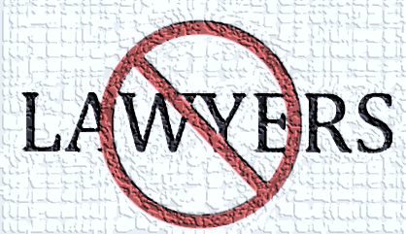
Change in Standard: Seagate Opinion (2007)
“Accordingly, we overrule the standard set out in Underwater Devices and hold that proof of willful infringement permitting enhanced damages requires at least a showing of objective recklessness. Because we abandon the affirmative duty of due care, we also reemphasize that there is no affirmative obligation to obtain opinion of counsel.”

Slide 4
35 U.S.C. § 298: No Adverse Inference Codified
“The failure of an infringer to obtain the advice of counsel with respect to any allegedly infringed patent, or the failure of an infringer to present such advice to the court or jury, may not be used to prove that the accused infringer willfully infringed the patent or that the infringer intended to induce infringement of the patent.” 35 U.S.C. § 298
After Seagate courts (including Fed. Cir.) were still giving real weight to failure to obtain opinion See e.g. Broadcom v. Qualcomm (Fed. Cir. 2008)
Congress removed this ambiguity

Slide 5
Halo: Infringer’s State of Mind and Opinions of Counsel
Halo:
Can no longer rely on defenses developed during litigation (Seagate objective prong vitiated)
Culpability assessed when infringement is occurring
Subjective state of mind (“am I a pirate?”)
Marks return to aspects of duty-of-care standard
So….
Pre-litigation advice of counsel is again front and center

Slide 6
Halo: Infringer’s State of Mind and Opinions of Counsel
Little guidance how courts should evaluate importance of opinion letters
Suggestion that opinions are “nice to have” not “need to have”:
“I do not say that a lawyer’s informed opinion would be unhelpful. To the contrary, consulting counsel may help draw the line between infringing and noninfringing uses. But on the other side of the equation lie the costs and the consequent risk of discouraging lawful innovation. Congress has thus left it to the potential infringer to decide whether to consult counsel—without the threat of treble damages influencing that decision.”
Halo, 136 S. Ct. 1923, 1937 (2016) (Breyer, J., concurring)

Slide 7
Post-Halo Decisions: Opinion Letters Matter
Survey of post-Halo cases reveals that advice of counsel is critical
In cases where timely opinion to form good faith belief of non-infringement or invalidity | Courts very likely not to enhance damages even if jury found willfulness
In cases where failure to reasonably investigate claims or otherwise rely on timely, competent advice | Almost always a finding of willful infringement and often enhanced damages

Slide 8
Post-Halo Decisions: Takeaways
Can’t use privilege as sword and shield - that’s what a pirate would do…
e.g. Trial cross-examination is not when to introduce advice of counsel!
Exmark Mfg. Co. v. Briggs & Stratton Corp., 2018 U.S. Dist. LEXIS 199483 (D. Neb. Nov. 26, 2018)

Slide 9
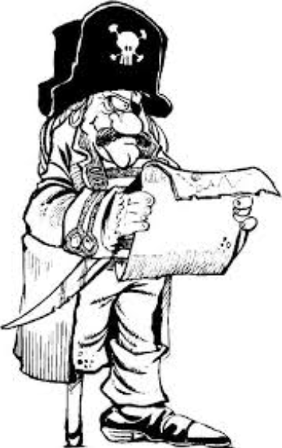
Post-Halo Decisions: Takeaways
Opinions obtained before infringing conduct began, and reasonably relied upon, can be particularly helpful, even if wrong
Greatbatch v. AVX, 2016 U.S. Dist. LEXIS 171939 (D. Del. Dec. 13, 2016)
Must have linking evidence of actual reliance on advice of counsel
Power Integrations v. Fairchild, 2018 U.S. Dist. LEXIS 186021 (D. Del. Oct. 31, 2018)
General knowledge of reexams or status of legal proceedings is not the same as subjective belief of invalidity/non-infringement
Power Integrations v. Fairchild, 2018 U.S. Dist. LEXIS 186021 (D. Del. Oct. 31, 2018)

Slide 10
Post-Halo Decisions: Takeaways
General alleged “oral” opinion, “we talked with counsel,” “got a clean bill of health” or “got the go”
PPC Broadband v. Corning Optical, 2016 U.S. Dist. LEXIS 152450 (N.D.N.Y. Nov. 3, 2016)
Polara v. Campbell, 894 F.3d 1339 (Fed. Cir. 2018)
Omega Patents v. Calamp, 2017 U.S. Dist. LEXIS 55846 (M.D. Fla. Apr. 6, 2017)
“Conducted only a cursory analysis of the patents [and] waited years before seeking advice of qualified and competent counsel.”
Arctic Cat v. Bombardier, 876 F.3d at 1371 (Fed. Cir. 2017)
Engineer performed “cursory study that was not corroborated by a prior art search or an infringement analysis”
Milwaukee Elec. Tool v. Snap-On, 288 F. Supp. 3d 872 (E.D. Wis. 2017)
Potentially “Piratey” approaches
Damages Enhanced!

Slide 11
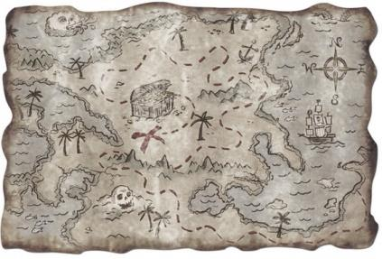
Post-Halo Decisions: Takeaways
But, comprehensive, reasonable investigation and opinion by technical team (sans lawyers) can help
Schwendimann v. Arkwright, 2018 U.S. Dist. LEXIS 127732 (D. Minn. July 30, 2018)
Sedecal v. Blue Ridge, 226 F. Supp. 3d 520 (W.D.N.C. 2016)
(no enhanced damages)
Careful about trying to bootstrap opinion about one product version to another (courts may reject)
PPC Broadband v. Corning Optical, 2016 U.S. Dist. LEXIS 152450 (N.D.N.Y. Nov. 3, 2016)
Opinions won’t be helpful if they don’t address the claims asserted in litigation
Polara v. Campbell, 894 F.3d 1339, 1354 (Fed. Cir. 2018)

Slide 12
Post-Halo Decisions: Takeaways
In context of post-verdict willfulness allegations, opinion letters may get short shrift…
VirnetX v. Apple, 324 F. Supp. 3d 836 (E.D. Tex. 2017)
One court found absence of opinion of counsel “surprising,” given size/scope of defendant’s patent portfolio – damages were enhanced – in tension with § 298?
Barry v. Medtronic, 876 F.3d at 1371 (Fed. Cir. 2017)

Slide 13
Opinion Letters: Practical Issues
How much to invest? When? What scope?
When to assert advice of counsel?! (not on cross at trial…)
Scope of waiver: must maintain separation / distinction between roles of opinion and litigation counsel
Special challenge where litigation counsel engages in pre-suit negotiations and opinions/guidance. Waiver re separate pre-suit opinions likely waives such pre-suit opinions too.
Zen Design Grp., Ltd. v. Scholastic, Inc.,
2018 U.S. Dist. LEXIS 104412 (E.D. Mich. June 22, 2018)
Manage level of formality of opinion

Slide 14
Questions?

