Slide 1
The Non-Doctrine of Redundancy: Contextual Data
Saurabh Vishnubhakat
Associate Professor of Law
Associate Professor of Engineering
22nd Annual BCLT & BTLJ Symposium
The Administrative Law of Intellectual Property

Slide 2
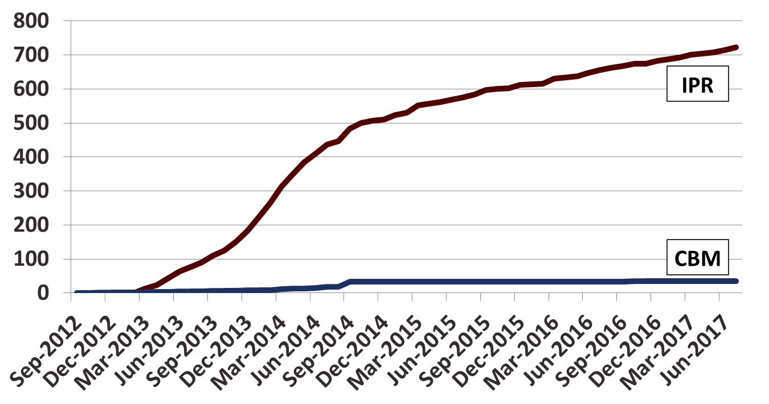
Use of Redundancy Grounds

Slide 3
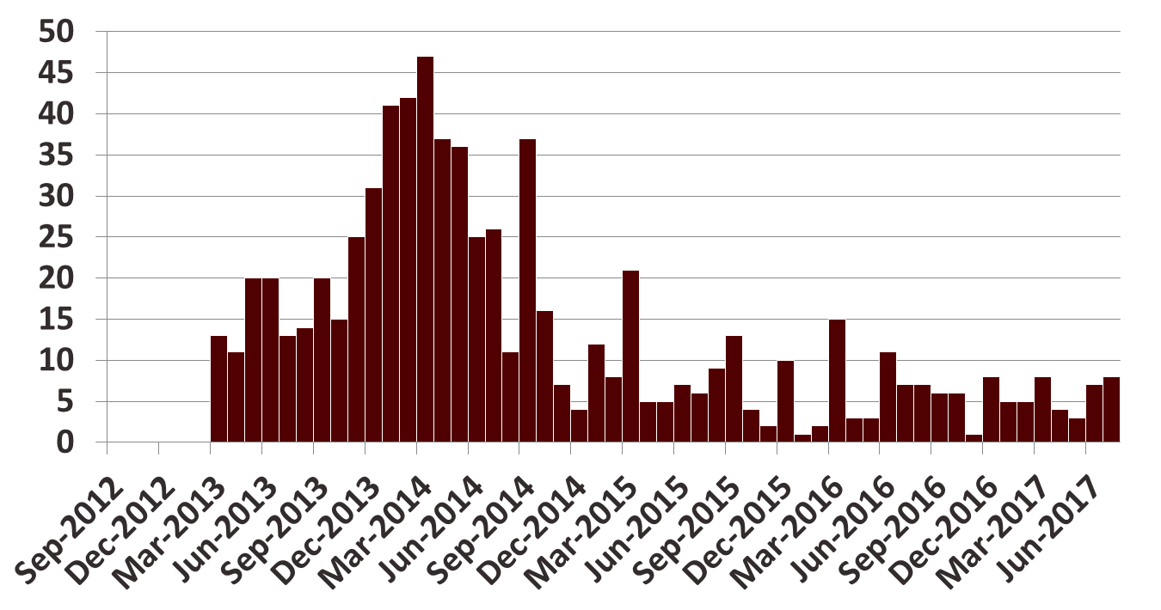
Use in Inter Partes Review

